Slide 1
Model Selection
SVR
MT
MLP
Results

Slide 2
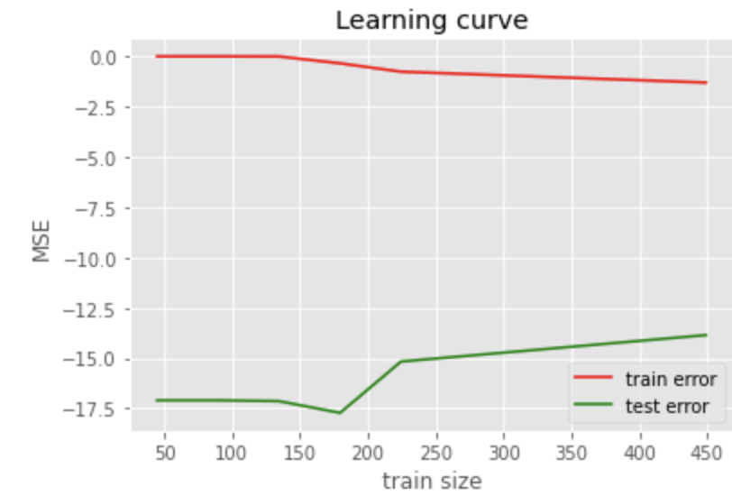
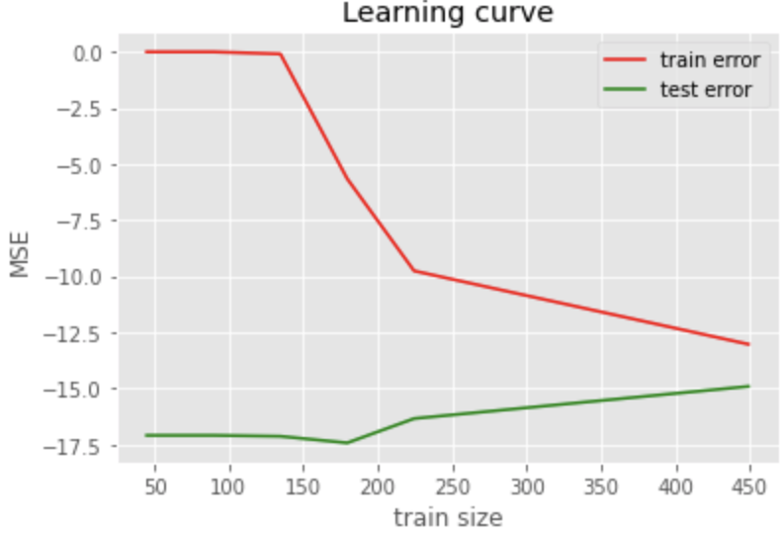
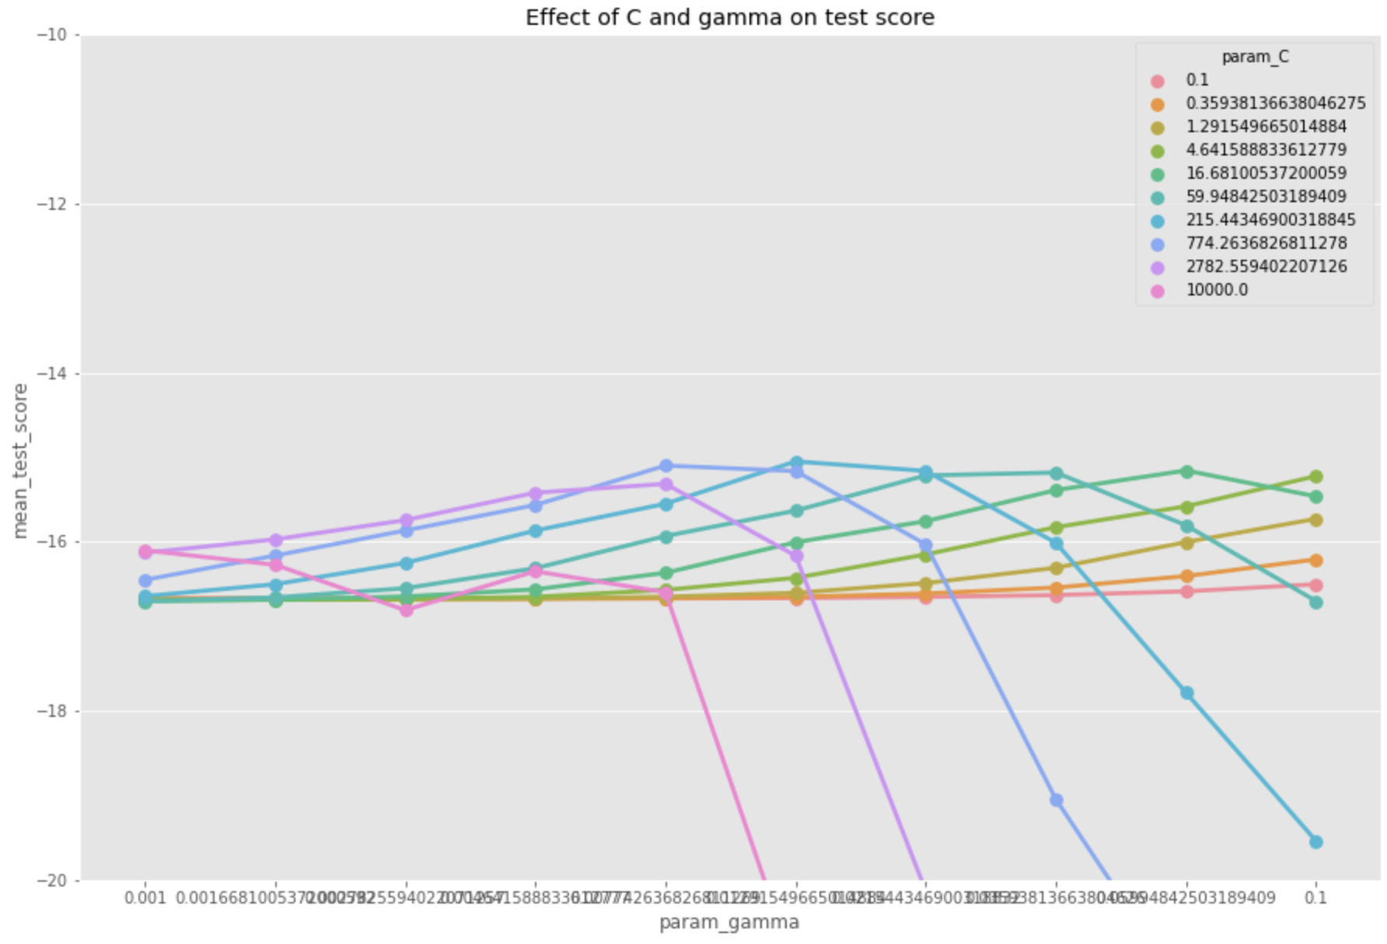
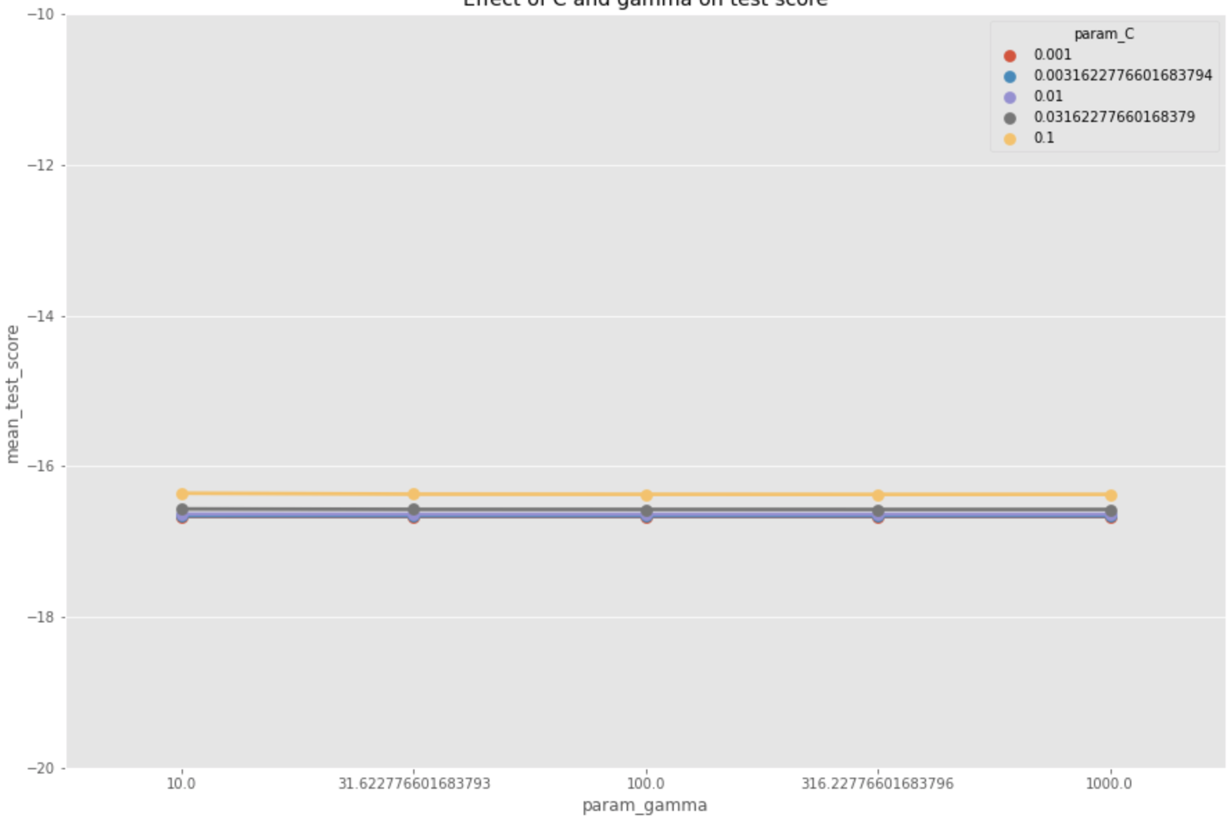
SVR (C, gamma, degree)
Large values of gamma and C tend to overfit but error is small.
gamma:np.logspace(1,3,5), MSE:13.855, Figure1. BEST: gamma: 1000.0 (edge of range)
gamma:np.logspace(-3,-1,5), MSE:15.0496, Figure2. BEST: gamma: 0.01 (middle of range)
Range for C is chosen so that the optimal value lies in range and RMSE is lowest
C:np.logspace(-3,-1,5), MSE:16.357, Figure3. BEST: C: 0.1 (edge of range)
C:np.logspace(-1,4,10), MSE:15.0496, Figure4. BEST: C: 215.44 (middle the range)
Range for degree is limited to [1,2] or [2,3] since training times for other values are too long.
Figure1.
Figure2.
Figure3.
Figure4.

Slide 3
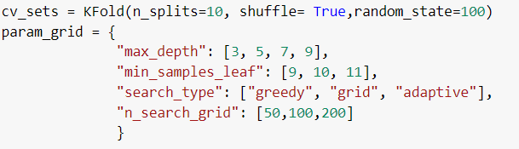
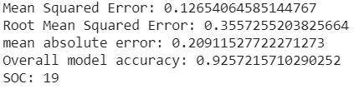
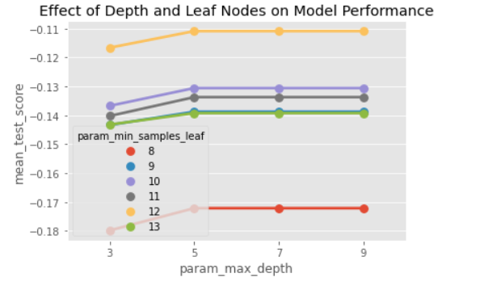
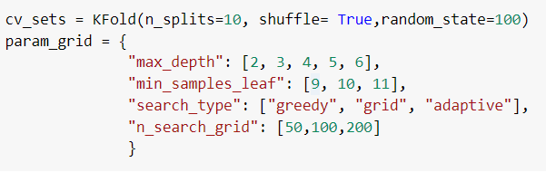
MT
Step 1. Parameter tuning, searching for best max_depth parameter

Slide 4
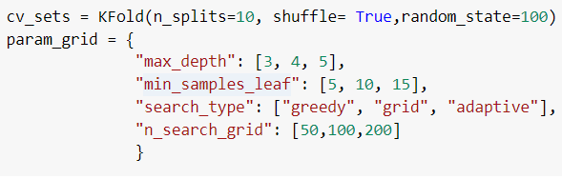
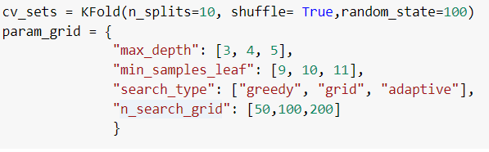
MT
Step 2. Searching best value for parameter min_samples_leaf

Slide 5
MLP
Step 1. Searching for the suitable network ( default hidden_layer_size = (100,) )
'activation': ['logistic', 'tanh', 'relu'], 'hidden_layer_sizes': [(100,), (100, 100), (100, 100, 100), (100, 100, 100, 100), (100, 100, 100, 100, 100)], 'learning_rate_init': np.logspace(-4,-2, 10)
Best : 'activation': 'relu', 'hidden_layer_sizes': (100, 100, 100, 100), 'learning_rate_init': 0.01
Mse : 12.29140932778277
Step 2. Shifting range depending on best parameter found in prev. Step
'hidden_layer_sizes': [(1,1,1,1), (10,10,10,10), (100, 100, 100, 100), (200,200,200,200)], 'learning_rate_init': np.logspace(-4,-2, 10)
Best : 'hidden_layer_sizes': (100, 100, 100, 100), 'learning_rate_init': 0.00046415888336127773
Mse : 8.178435941033133
Step 3. Repetition. Shifting range depending on best parameter found in prev. Step
'hidden_layer_sizes': [(150,150,150,150), (100, 100, 100, 100), (50,50,50,50)], 'learning_rate_init': np.logspace(-4,-2, 10)
Best : 'hidden_layer_sizes': (100, 100, 100, 100), 'learning_rate_init': 0.002154434690031882
Mse : 6.611754837102716
Step 4. Repetition. Shifting range depending on best parameter found in prev. Step
'hidden_layer_sizes': [(75,750,75,75), (125,125,125,125), (100, 100, 100, 100)], 'learning_rate_init': np.logspace(-4,-2, 10)
Best : 'hidden_layer_sizes': (75, 750, 75, 75), 'learning_rate_init': 0.003593813663804626
Mse : 4.782631562000682

Slide 6
Results
Format: MSE & SOC MAE & SOC
Datasets Models | Servo | Auto MPG | Forest Fire
MLP | 0.0402 & 308 0.1358 & 308 | 4.7826 & 4514 1.7318 & 4514 | 11.2394 & 28 2.0124 & 28
MT | 0.1266 & 19 0.2091 & 19 | 5.4701 & 21 1.7803 & 21 | 18.694 & 23 3.089 & 23
SVR | 0.1302 & 1261 0.2277 & 1183 | 6.7179 & 7106 1.9413 & 7201 | 13.65 & 10700 2.1880 & 10170
Ref (MSE & MAE) | 0.800 & 0.220 | 3.730 & 2.020 | 16.400 & 6.334

Slide 7
Results(graphs go here)

